Slide 1
Forensic Science Laboratories
Abhishek Prajapati
Research scholar
National Forensic Sciences University

Slide 2
Forensic Science Laboratory
Multidisciplinary laboratory serving various branches of forensic science
Provides scientific support and services in criminal investigations
Answers the queries of the Court of Law with scientific evidence
Functions at both Central and State levels

Slide 3
Directorate of Forensic Science Services (DFSS)
Created in 2002 by Ministry of Home Affairs, Govt. of India
Formed after bifurcation from BPR&D on recommendations of NHRC & Padmanabhaiah Committee on Police Reforms
Mission: “To render high-quality and credible forensic services to the justice delivery system”
Provide scientific support in criminal investigations and assist Courts of Law

Slide 4
DFSS
CFSL KOLKATA (1957)
CFSL HYDERABAD (1968)
CFSL CHANDIGARH (1972)
CFSL BHOPAL (2011)
CFSL Guwahati (2011)
CFSL PUNE (2011)
*CFSL CBI DELHI

Slide 5
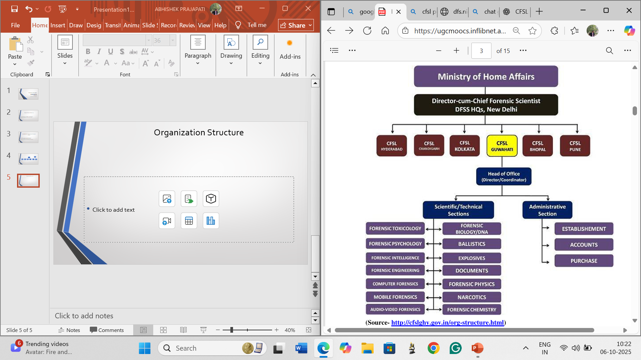
Organization Structure

Slide 6
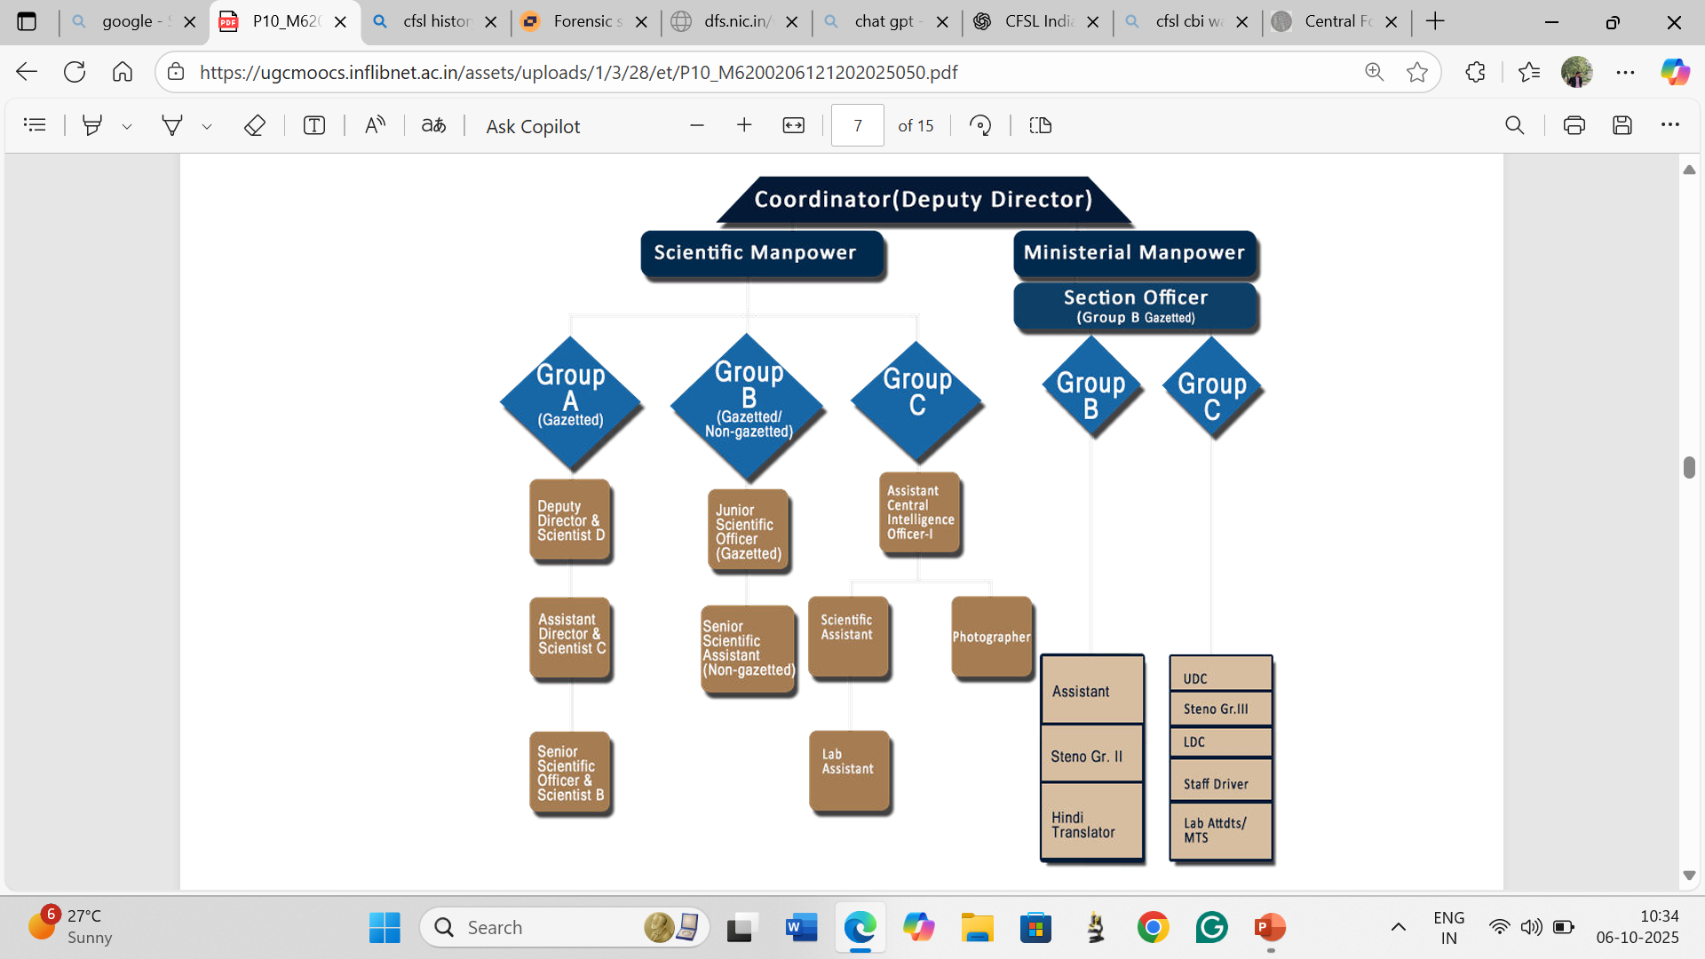
Hierarchical setup of CFSLs

Slide 7
Functions of Central Forensic Science Laboratory (CFSL)
Evidence Collection & Examination
Investigating officer collects and preserves exhibits from the crime scene
Exhibits sent by police with requisition and questionnaire
Priority given to important cases
Reports sent to concerned police station
Examiner appears in court on summons to present report

Slide 8
Support to State FSLs
Handles cases that State Forensic Science Laboratories cannot examine
Advisory Role
Assists and advises Central & State Governments on forensic matters
Provides forensic assistance during national disasters/calamities

Slide 9
National Forensic Database
Develops databases on various forensic indices
Helps control recidivism & repeat crimes
Strengthens homeland security
Quality Forensic Services
Provides high-quality, timely services to the criminal justice delivery system
Builds capacity and capability at the central level

Slide 10
Limitations of CFSL
Dependent on Evidence Handling
Quality of results relies on proper collection & preservation of evidence
Poor handling by investigating officers can affect entire analysis
Instrumental Limitations
Small quantity of exhibits at crime scenes may not be suitable for available techniques
Limited or outdated equipment can restrict accurate analysis
Connectivity & Digitalization Issues
State FSLs not fully connected to CFSLs via internet
Lack of real-time data sharing between laboratories
No direct digital link between crime scene & labs

Slide 11
References
http://cfslghy.gov.in/org-structure.html
http://cfslpune.gov.in/about-cfsl.php
https://share.google/kgLHrz9FtwEaBm03J

